Slide 1
On-Premise Exchange

Slide 2
Prerequisites
Exchange user with ApplicationImpersonation role/right – Password should never expire
Basic Authentication on BOTH autodiscover and EWS. On every Exchange server they have
DNS SRV Record
Retain and Exchange servers MUST be on the same DNS.

Slide 3
Create Impersonation User
Create new user in Exchange.
Must be an active user with password setup. (mailbox-enabled user)
Make sure this password NEVER expires.
Assign the right ApplicationImpersonation to the user and nothing else.
Must not be given any Admin rights or roles.

Slide 4
Basic Authentication Exchange 2013+
Exchange Admin Center | Servers | Virtual Directories tab

Slide 5
Basic Authentication
Exchange 2010 or older:

Slide 7
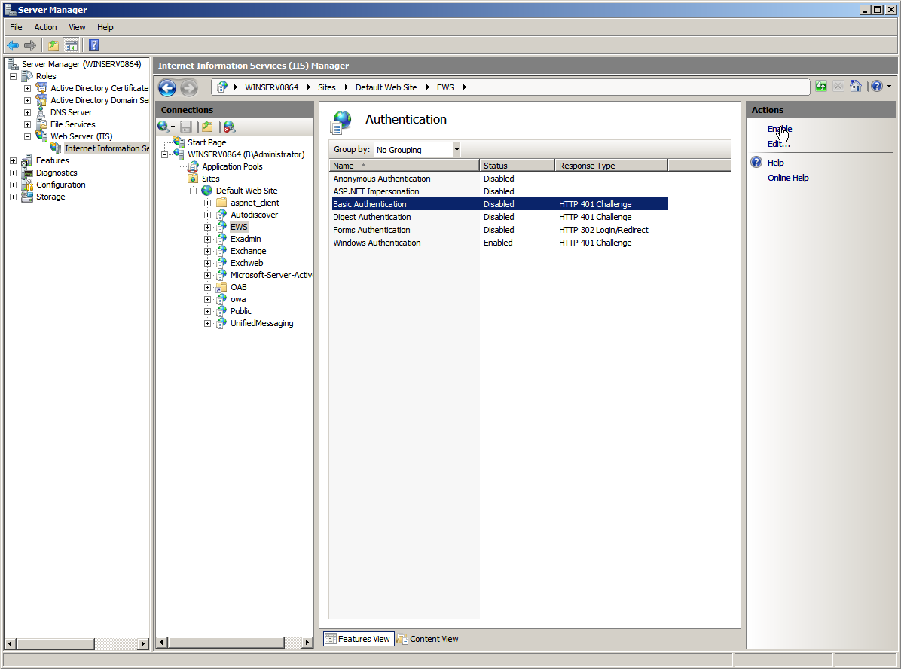

Slide 8
DNS SRV Record
Have the admin log into their DNS and add this record:
Service: _autodiscover
Protocol: _tcp
Port Number: 443
Host: [your mail host, e.g. mail.gwava.net, usually the AD domain forest found in AD Domains and Trusts on the MS AD server]

Slide 9
In-place Hold
Groupwise email archived before it can be deleted from trash.
Exchange does not have the same ability
Setup a In-Place hold for 15-30 days or as needed
https://www.novell.com/documentation/retain-47/retain/data/t44xoj88yq0m.html#t44bt9lc2kek
https://support.microfocus.com/kb/doc.php?id=7019539

Slide 10
Exchange Module
Change Module name

Slide 11
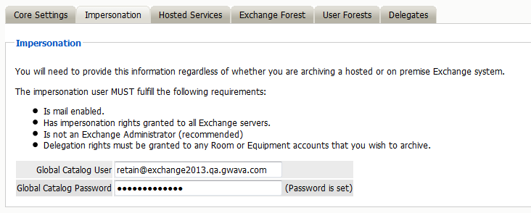
Impersonation tab

Slide 12
Exchange Forest

Slide 14
Test Connection
http://(URL)/RetainServer/mod-19/Util/testExchange.jsp
Great section to test connectivity and make sure all settings are correct.

Slide 15
Job Configuration
Module Config | refresh the AddressBook – Link Accounts
Setup Schedule, profile, and Worker as needed
Setup job with schedule, profile, and worker settings
Enable Journaling or archive users. Not both
Try not to archive by mail server. Use Distribution Lists (Exchange calls them groups) as you are able.
Setup Notification

Slide 16
Common Errors
https://support.microfocus.com/kb/doc.php?id=7020663
"No Autodiscover/Endpoint found!“ – DNS SRV record invalid or not found or Retain and Exchange are not on the same DNS.
DNS name not found [response code 3] – Basic Authentication is not enabled on autodiscover, SRV incorrect or missing, Impersonation user’s password expired.
The server sent HTTP status code 401: Unauthorized – Basic authentication is enabled on autodiscover but not enabled on EWS

Slide 17
Questions?

