Slide 1
Blackberry Module

Slide 2
Prerequisites
Retain archives by accessing the BB Logs. Therefore, Blackberry needs to setup logging for all desired data
For BES 10.x and 12.x, users must be set Regulated mode and have the logging set to ‘yes’ for all types desired.
Users created should have a Blackberry PIN assigned along with name and phone number in the Blackberry system
Notes:
How presentation will benefit audience: Adult learners are more interested in a subject if they know how or why it is important to them.
Presenter’s level of expertise in the subject: Briefly state your credentials in this area, or explain why participants should listen to you.

Slide 3
Getting Blackberry Server Ready
Find the Blackerry logs on the BES Server
Create a mount or mapped drive from the Retain to the BES Logs
Make sure Retain has full access to read and write to the log directory
Notes:
Example objectives
At the end of this lesson, you will be able to:
Save files to the team Web server.
Move files to different locations on the team Web server.
Share files on the team Web server.

Slide 4
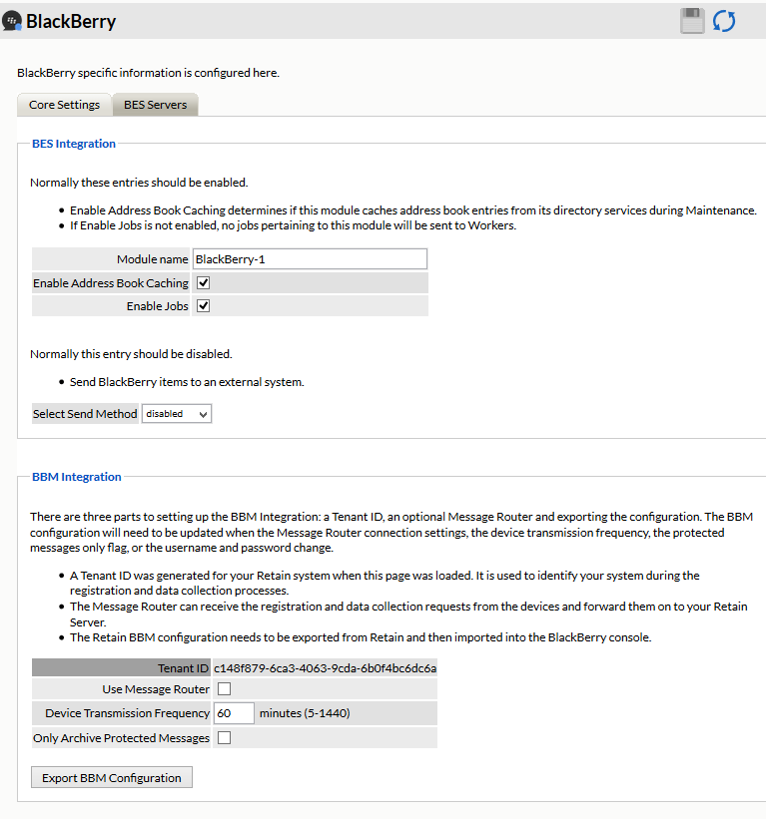
Module Configuration
Fill in the Module name
Check box for caching and jobs
Notes:
Lesson descriptions should be brief.

Slide 5
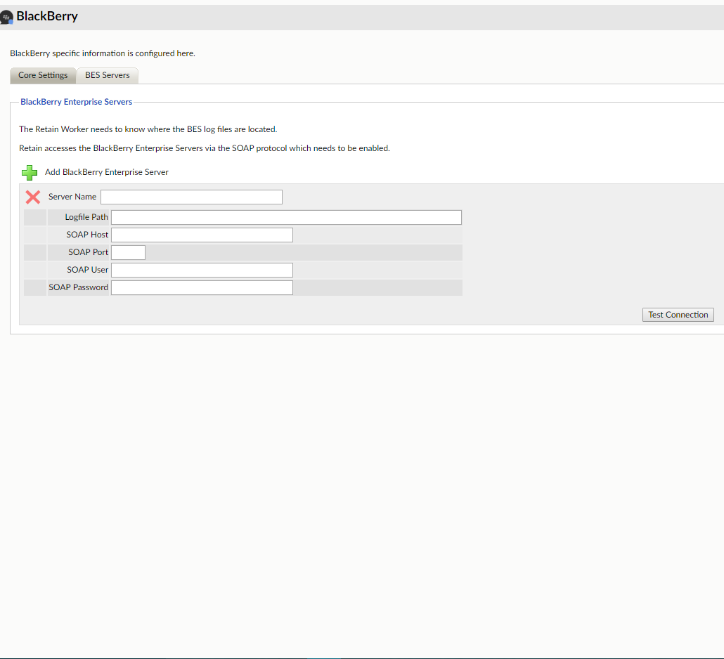
Module Configuration
Specify a server name
Input the location to the BES logs
All SOAP information is for Addressbook sync information
Addressbook sync will have all users found show up in Device Management
Notes:
Lesson descriptions should be brief.

Slide 6
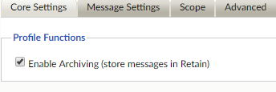
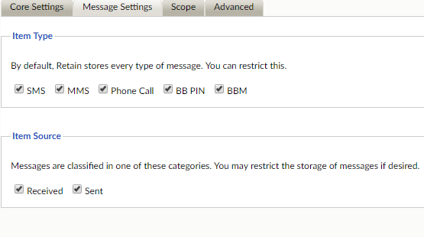
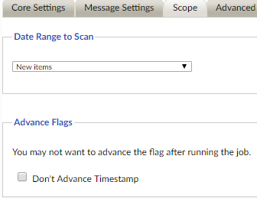
Setup a Schedule, Profile, and Worker
Create or use an existing schedule
Setup a new Profile for the Blackberry module
Profile will look much like a regular Archive job.
Use a RetainWorker for the job

Slide 7
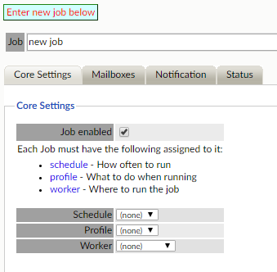
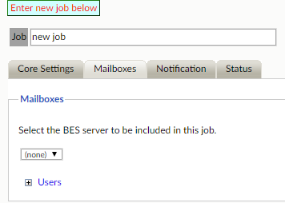
Setup Blackberry Job

Slide 8
Issues to be aware of
RET-10792 – Retain is processing all log data despite being set to New Items in the profile.
RET-10669 – Device Management not updating with Addressbook Sync

Slide 9
Questions?

