Slide 1
Mobile Archiving

Slide 2
Requirements
Android 4.4+
Specific Storage Path must be manually created If they use the Message Router.
International devices must connect with port 80
Retain Service APK must be installed prior to registration
Setup IMEI registration with Licensing.

Slide 3
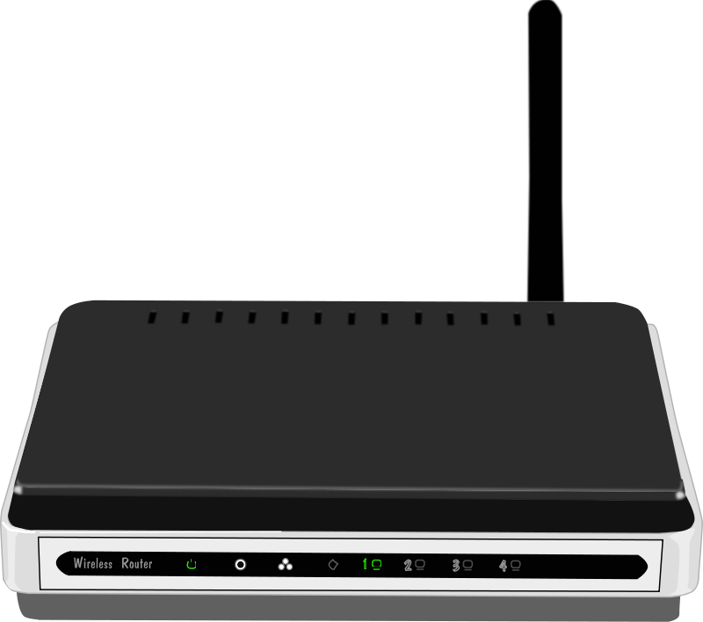
Basic Setup
Android
MDM
MDM
Android

Slide 4
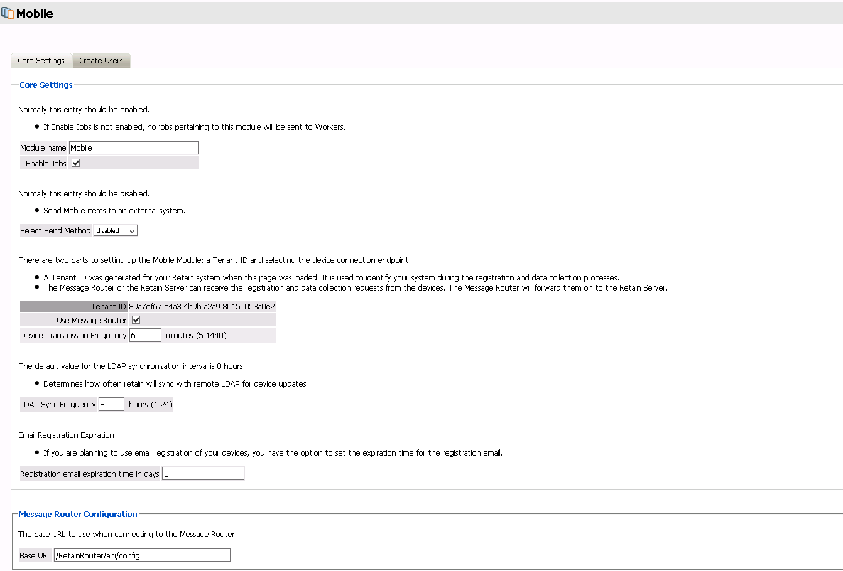
Module Setup
No longer required
How often Retain will archive mobile data.
Range is 5 minutes to 1 day
Range is 1 day to 30 days max

Slide 5
Profile Setup
Enable the archiving and then leave the defaults for the rest (archive everything)
Core Settings: Enable Archive
Message Settings:
Select All for Item Type
Select All for Item Source
Miscellaneous: Store all attachments
Max size = -1 (meaning no limit)

Slide 6
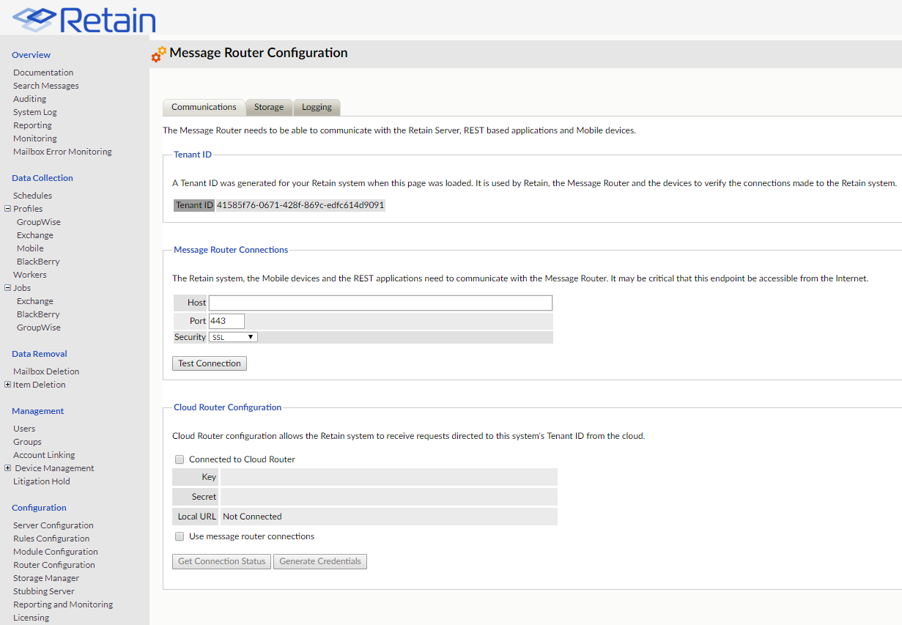
Router Setup (optional)

Slide 7
Router Setup (optional): continued
Linux Path example: /retain/router/temp
Windows Path example: C:\Retain\temp

Slide 8
Server Configuration

Slide 9
Setup Router page.

Slide 10
Retain Service app
Go to Retain | Tools to get APK
Either manually install APK on the device or have MDM push app to all devices
This is NOT the same app that is found on the Google / Apple app stores.

Slide 11
How to register a device – 3 ways

Slide 12
Step 1 - Add Device

Slide 13
Mobile Registration: Method 1 – IMEI
Make sure CMS is setup under Server Configuration in Retain
Retain Service App can NOT be running. Must be installed, but must not be running at all.
During Add Device stage, check the box for IMEI registration and put in correct IMEI device information

Slide 14
Mobile Registration: Method 2 – Email Registration
After adding a device, an email is sent to the email specified
Email opened on the phone is a MUST
Retain Service App can NOT be running. Must be installed, but must not be running at all.
This will open the Retain App and authenticate the information.

Slide 15
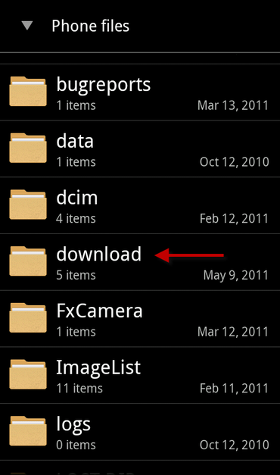
Mobile Registration: Method 3 – JSON File
Open Registration email on the phone
Download and save the JSON file to the phone
The JSON file needs to be in the phone’s Download folder
This is located on the root directory. From a linux point of view,
The location would look like /download
Open Retain Service App and it will grab the JSON file from the
Download folder on the phone and register the device

Slide 16
Mobile Registration: Re-registration
Used for when devices stopped communicating with Retain
Will only send out Registration email. This means email or JSON registration only
Not possible to use reregister device with IMEI registration.
To re-register device using IMEI, delete user and re-add.

Slide 17
Batch Device Registration
Used for registering a bunch of devices all at once.
The file uploaded MUST be in CSV format.

Slide 18
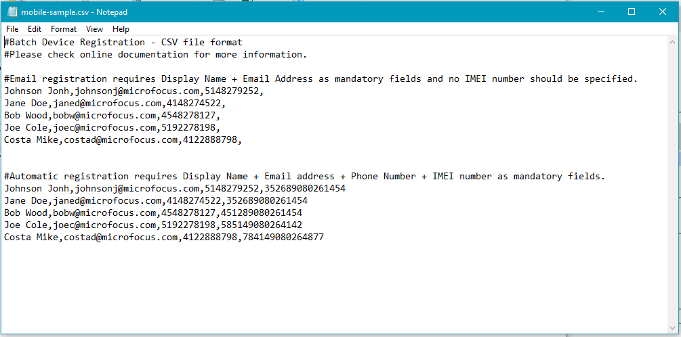
Batch Device Registration

Slide 19
Major Issue to be aware of
RET-10591 - Unable to register devices with IIS
Issue requirements include:
Customer is using the Message Router
Both Retain and the Message Router are using Windows as their Server OS
Both Retain and Message Router are using IIS as the Web Service
Workaround solution:
Setup communication between Server and Message Router on port 48080.
Or, Setup Router on Linux using Apache

Slide 20
Questions?

